Slide 1
Global Baseline Estimate
Movie Recommendation System
CUNY M.S. in Data Science
Kingsley Kojo Kpoku
Notes:
Introduce the assignment. Explain that the goal is to use movie survey ratings to predict a missing rating.

Slide 2
3. My Data
8 participants
10 movies
Ratings use a 1–5 scale
Some ratings are missing (NA)
Data is organized in tidy/long format in R
Notes:
The missing ratings are important because they give the recommendation system something to predict.

Slide 3
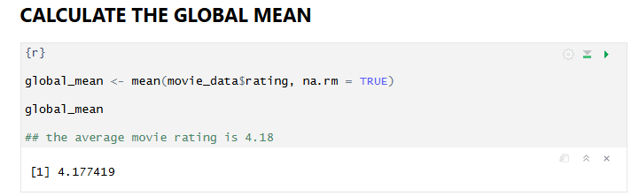
4. The Global Mean
Global Mean = average of all available ratings
Missing ratings are excluded
Global Mean = 4.18
Notes:
The global mean provides the baseline for the entire dataset. My calculated global mean is approximately 4.18.

Slide 4
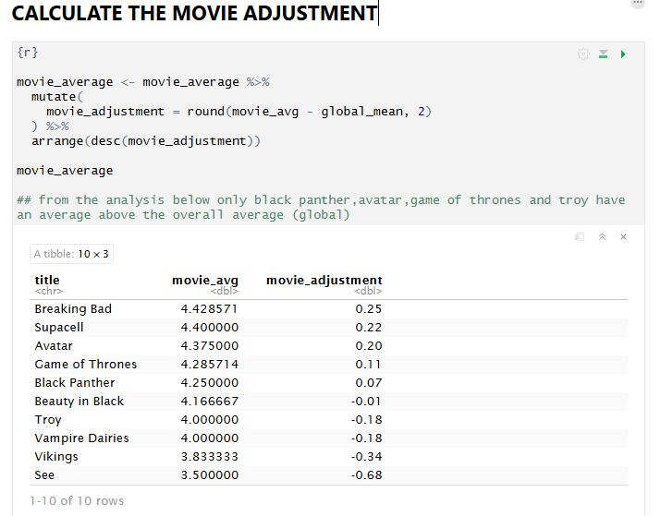
5. Movie Adjustment
Movie Adjustment = Movie Average − Global Mean
Positive value → above the overall average
Negative value → below the overall average
Notes:
I compare each movie's average rating with 4.18. This shows whether the movie is rated higher or lower than the overall dataset.

Slide 5
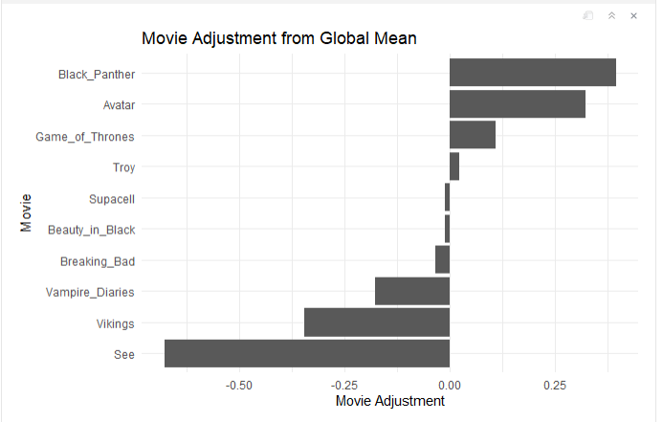
6. Movie Results
Black Panther: +0.39
Avatar: +0.32
Game of Thrones: +0.11
See: −0.68
Notes:
Black Panther has the largest positive adjustment, while See has the largest negative adjustment. These are adjustments, not actual ratings.

Slide 6
7. User Adjustment
User Adjustment = User Average − Global Mean
Shows whether a participant generally rates higher or lower
Calculated for the participant whose missing rating is being predicted
Notes:
The user adjustment adds the participant's own rating behavior to the prediction. It should be calculated for the selected respondent.

Slide 7
10. Analytics Findings
Global mean rating: 4.18
Black Panther: highest positive adjustment (+0.39)
See: largest negative adjustment (−0.68)
Movie ratings vary around the global baseline
Notes:
The results show meaningful differences between movie ratings and the overall baseline.

Slide 8
11. Conclusion
The Global Baseline Estimate is a simple recommendation approach
It combines overall, movie-level, and user-level information
It can estimate missing ratings
The analysis shows how averages can be turned into a recommendation
Notes:
In conclusion, the algorithm provides a simple way to estimate a missing movie rating using information from the whole dataset, the movie, and the participant.

Slide 9
AI USE
ChatGPT was used as a supporting tool
Assisted with R coding, concepts, and visualization
All code and analytical suggestions were reviewed and tested by me
Notes:
Explain that AI was used as a supporting tool and that the final work was reviewed and tested.

Slide 10
Thank You
Global Baseline Estimate
Movie Recommendation System
Questions?
Notes:
Thank the audience and invite questions.

